Slide 1

CSD 3102-ARTIFICIAL INTELLIGENCE TECHNIQUES
•
MODULE 3
Representing Knowledge using Rules

Slide 2
MODULE III KNOWLEDGE AND REASONING 9
Knowledge Representation-Knowledge based Agents-The Wumpus World Logic-Propositional Logic-Predicate Logic-Unification and Lifting - Representing Knowledge using Rules-Semantic Networks Frame Systems Inference – Types of Reasoning.

Slide 3
Procedural and Declarative Knowledge
Procedural Knowledge
The Procedural knowledge is a type of knowledge where the essential control information that is required to use the information is integrated in the knowledge itself.
It also used with an interpreter to employ the knowledge which follows the instructions given in the knowledge.
Ex - It can include a group of logical assertions merged with a resolution theorem prove to provide an absolute program for solving problems. Here, the implied income tax of an employee salary can be thought of as a procedural knowledge as it would require a process to calculate it as given below.

Slide 4
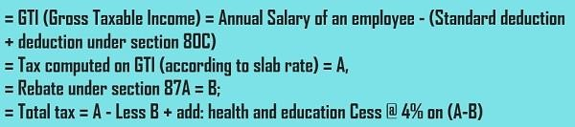
So, this is how the tax of an employee is calculated by following a lengthy process instead of just collecting facts.
Declarative Knowledge
A Declarative knowledge is where only knowledge is described but not the use to which the knowledge is employed is not provided.
So, in order to use this declarative knowledge, we need to add it with a program that indicates what is to be done to the knowledge and how it is to be done.

Slide 5
Difference the Procedural and Declarative Knowledge
PROCEDURAL KNOWLEDGE | DECLARATIVE KNOWLEDGE
It is also known as Interpretive knowledge. | It is also known as Descriptive knowledge.
Procedural Knowledge means how a particular thing can be accomplished | While Declarative Knowledge means basic knowledge about something.
Procedural Knowledge is generally not used means it is not more popular. | Declarative Knowledge is more popular.
Procedural Knowledge can’t be easily communicate. | Declarative Knowledge can be easily communicate
Procedural Knowledge is generally process oriented in nature | Declarative Knowledge is data oriented in nature.
In Procedural Knowledge debugging and validation is not easy. | In Declarative Knowledge debugging and validation is easy.

Slide 6
Forward Reasoning
The solution of a problem generally includes the initial data and facts in order to arrive at the solution. These unknown facts and information is used to deduce the result
For example, while diagnosing a patient the doctor first check the symptoms and medical condition of the body such as temperature, blood pressure, pulse, eye colour, blood, etcetera. After that, the patient symptoms are analysed and compared against the predetermined symptoms. Then the doctor is able to provide the medicines according to the symptoms of the patient. So, when a solution employs this manner of reasoning, it is known as forward reasoning.

Slide 7
Steps that are followed in the forward reasoning
In the first step, the system is given one or more than one constraints.
Then the rules are searched in the knowledge base for each constraint. The rules that fulfill the condition are selected(i.e., IF part).
Now each rule is able to produce new conditions from the conclusion of the invoked one. As a result, THEN part is again included in the existing one.
The added conditions are processed again by repeating step 2. The process will end if there is no new conditions exist.

Slide 8
Example knowledge base
The law says that it is a crime for an American to sell weapons to hostile nations. The country Nono, an enemy of America, has some missiles, and all of its missiles were sold to it by Colonel West, who is American.
Prove that Col. West is a criminal

Slide 9
Example knowledge base contd.
... it is a crime for an American to sell weapons to hostile nations:

Slide 10
Example knowledge base contd.
... it is a crime for an American to sell weapons to hostile nations:
American(x) ∧ Weapon(y) ∧ Sells(x,y,z) ∧ Hostile(z) ⇒ Criminal(x)

Slide 11
Example knowledge base contd.
... it is a crime for an American to sell weapons to hostile nations:
American(x) ∧ Weapon(y) ∧ Sells(x,y,z) ∧ Hostile(z) ⇒ Criminal(x)
Nono … has some missiles

Slide 12
Example knowledge base contd.
... it is a crime for an American to sell weapons to hostile nations:
American(x) ∧ Weapon(y) ∧ Sells(x,y,z) ∧ Hostile(z) ⇒ Criminal(x)
Nono … has some missiles, i.e., ∃x Owns(Nono,x) ∧ Missile(x):
Owns(Nono,M₁) and Missile(M₁)

Slide 13
Example knowledge base contd.
... it is a crime for an American to sell weapons to hostile nations:
American(x) ∧ Weapon(y) ∧ Sells(x,y,z) ∧ Hostile(z) ⇒ Criminal(x)
Nono … has some missiles, i.e., ∃x Owns(Nono,x) ∧ Missile(x):
Owns(Nono,M₁) and Missile(M₁)
… all of its missiles were sold to it by Colonel West

Slide 14
Example knowledge base contd.
... it is a crime for an American to sell weapons to hostile nations:
American(x) ∧ Weapon(y) ∧ Sells(x,y,z) ∧ Hostile(z) ⇒ Criminal(x)
Nono … has some missiles, i.e., ∃x Owns(Nono,x) ∧ Missile(x):
Owns(Nono,M₁) and Missile(M₁)
… all of its missiles were sold to it by Colonel West
Missile(x) ∧ Owns(Nono,x) ⇒ Sells(West,x,Nono)

Slide 15
Example knowledge base contd.
... it is a crime for an American to sell weapons to hostile nations:
American(x) ∧ Weapon(y) ∧ Sells(x,y,z) ∧ Hostile(z) ⇒ Criminal(x)
Nono … has some missiles, i.e., ∃x Owns(Nono,x) ∧ Missile(x):
Owns(Nono,M₁) and Missile(M₁)
… all of its missiles were sold to it by Colonel West
Missile(x) ∧ Owns(Nono,x) ⇒ Sells(West,x,Nono)
Missiles are weapons:

Slide 16
Example knowledge base contd.
... it is a crime for an American to sell weapons to hostile nations:
American(x) ∧ Weapon(y) ∧ Sells(x,y,z) ∧ Hostile(z) ⇒ Criminal(x)
Nono … has some missiles, i.e., ∃x Owns(Nono,x) ∧ Missile(x):
Owns(Nono,M₁) and Missile(M₁)
… all of its missiles were sold to it by Colonel West
Missile(x) ∧ Owns(Nono,x) ⇒ Sells(West,x,Nono)
Missiles are weapons:
Missile(x) ⇒ Weapon(x)

Slide 17
Example knowledge base contd.
... it is a crime for an American to sell weapons to hostile nations:
American(x) ∧ Weapon(y) ∧ Sells(x,y,z) ∧ Hostile(z) ⇒ Criminal(x)
Nono … has some missiles, i.e., ∃x Owns(Nono,x) ∧ Missile(x):
Owns(Nono,M₁) and Missile(M₁)
… all of its missiles were sold to it by Colonel West
Missile(x) ∧ Owns(Nono,x) ⇒ Sells(West,x,Nono)
Missiles are weapons:
Missile(x) ⇒ Weapon(x)
An enemy of America counts as "hostile“:

Slide 18
Example knowledge base contd.
... it is a crime for an American to sell weapons to hostile nations:
American(x) ∧ Weapon(y) ∧ Sells(x,y,z) ∧ Hostile(z) ⇒ Criminal(x)
Nono … has some missiles, i.e., ∃x Owns(Nono,x) ∧ Missile(x):
Owns(Nono,M₁) and Missile(M₁)
… all of its missiles were sold to it by Colonel West
Missile(x) ∧ Owns(Nono,x) ⇒ Sells(West,x,Nono)
Missiles are weapons:
Missile(x) ⇒ Weapon(x)
An enemy of America counts as "hostile“:
Enemy(x,America) ⇒ Hostile(x)

Slide 19
Example knowledge base contd.
... it is a crime for an American to sell weapons to hostile nations:
American(x) ∧ Weapon(y) ∧ Sells(x,y,z) ∧ Hostile(z) ⇒ Criminal(x)
Nono … has some missiles, i.e., ∃x Owns(Nono,x) ∧ Missile(x):
Owns(Nono,M₁) and Missile(M₁)
… all of its missiles were sold to it by Colonel West
Missile(x) ∧ Owns(Nono,x) ⇒ Sells(West,x,Nono)
Missiles are weapons:
Missile(x) ⇒ Weapon(x)
An enemy of America counts as "hostile“:
Enemy(x,America) ⇒ Hostile(x)
West, who is American …

Slide 20
Example knowledge base contd.
... it is a crime for an American to sell weapons to hostile nations:
American(x) ∧ Weapon(y) ∧ Sells(x,y,z) ∧ Hostile(z) ⇒ Criminal(x)
Nono … has some missiles, i.e., ∃x Owns(Nono,x) ∧ Missile(x):
Owns(Nono,M₁) and Missile(M₁)
… all of its missiles were sold to it by Colonel West
Missile(x) ∧ Owns(Nono,x) ⇒ Sells(West,x,Nono)
Missiles are weapons:
Missile(x) ⇒ Weapon(x)
An enemy of America counts as "hostile“:
Enemy(x,America) ⇒ Hostile(x)
West, who is American …
American(West)

Slide 21
Example knowledge base contd.
... it is a crime for an American to sell weapons to hostile nations:
American(x) ∧ Weapon(y) ∧ Sells(x,y,z) ∧ Hostile(z) ⇒ Criminal(x)
Nono … has some missiles, i.e., ∃x Owns(Nono,x) ∧ Missile(x):
Owns(Nono,M₁) and Missile(M₁)
… all of its missiles were sold to it by Colonel West
Missile(x) ∧ Owns(Nono,x) ⇒ Sells(West,x,Nono)
Missiles are weapons:
Missile(x) ⇒ Weapon(x)
An enemy of America counts as "hostile“:
Enemy(x,America) ⇒ Hostile(x)
West, who is American …
American(West)
The country Nono, an enemy of America …

Slide 22
Example knowledge base contd.
... it is a crime for an American to sell weapons to hostile nations:
American(x) ∧ Weapon(y) ∧ Sells(x,y,z) ∧ Hostile(z) ⇒ Criminal(x)
Nono … has some missiles, i.e., ∃x Owns(Nono,x) ∧ Missile(x):
Owns(Nono,M₁) and Missile(M₁)
… all of its missiles were sold to it by Colonel West
Missile(x) ∧ Owns(Nono,x) ⇒ Sells(West,x,Nono)
Missiles are weapons:
Missile(x) ⇒ Weapon(x)
An enemy of America counts as "hostile“:
Enemy(x,America) ⇒ Hostile(x)
West, who is American …
American(West)
The country Nono, an enemy of America …
Enemy(Nono,America)

Slide 23
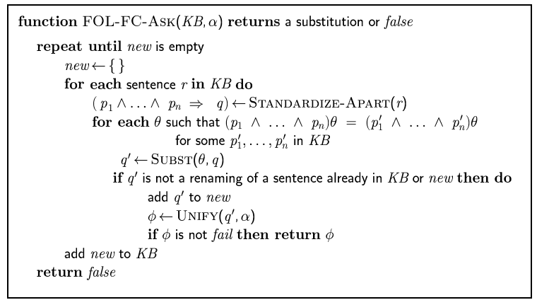
Forward chaining algorithm

Slide 24
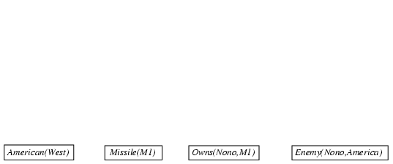
Forward chaining example

Slide 25
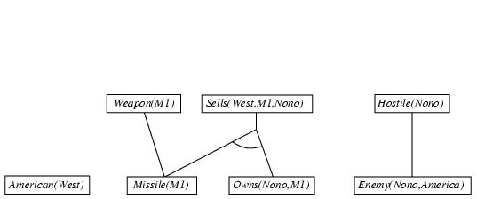
Forward chaining example

Slide 26
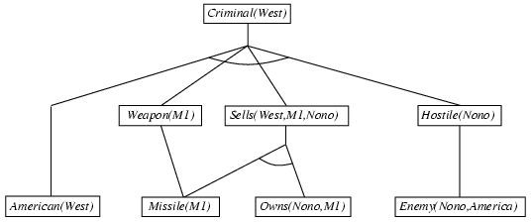
Forward chaining example

Slide 27
Backward Reasoning
The backward reasoning is inverse of forward reasoning in which goal is analysed in order to deduce the rules, initial facts and data.
We can understand the concept by the similar example given in the above definition, where the doctor is trying to diagnose the patient with the help of the inceptive data such as symptoms. However, in this case, the patient is experiencing a problem in his body, on the basis of which the doctor is going to prove the symptoms. This kind of reasoning comes under backward reasoning.

Slide 28
Steps that are followed in the backward reasoning
Firstly, the goal state and the rules are selected where the goal state reside in the THEN part as the conclusion.
From the IF part of the selected rule the sub goals are made to be satisfied for the goal state to be true.
Set initial conditions important to satisfy all the sub goals.
Verify whether the provided initial state matches with the established states. If it fulfills the condition then the goal is the solution otherwise other goal state is selected.

Slide 29
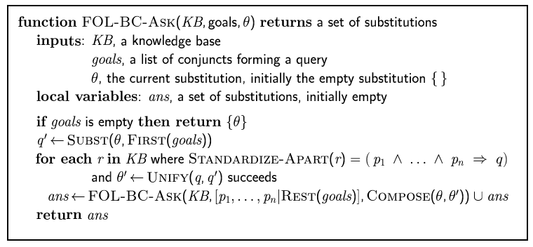
Backward chaining algorithm

Slide 30

Backward chaining example

Slide 31
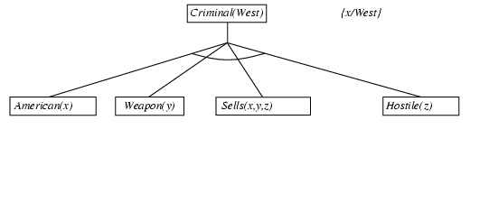
Backward chaining example

Slide 32
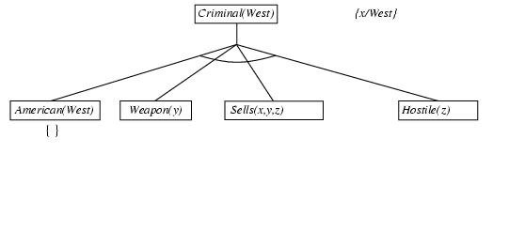
Backward chaining example

Slide 33
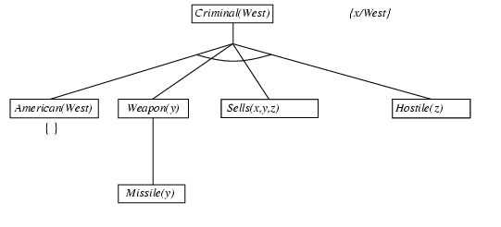
Backward chaining example

Slide 34
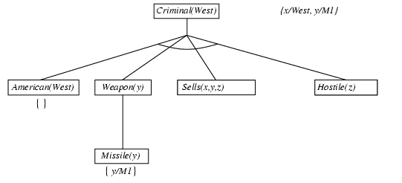
Backward chaining example

Slide 35
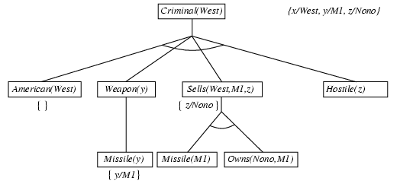
Backward chaining example

Slide 36
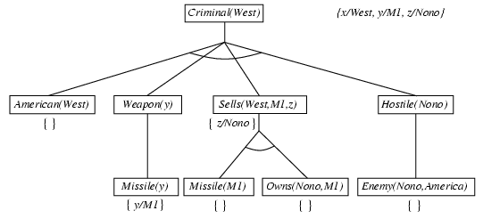
Backward chaining example

Slide 37
Backward chaining example

Slide 38
Properties of backward chaining
Depth-first recursive proof search: space is linear in size of proof.
Incomplete due to infinite loops
fix by checking current goal against every goal on stack
Inefficient due to repeated subgoals (both success and failure)
fix using caching of previous results (extra space!!)
Widely used for logic programming

Slide 39
Difference between backward chaining and forward chaining
Forward Chaining | Backward Chaining
It starts from known facts and applies inference rule to extract more data unit it reaches to the goal. | It starts from the goal and works backward through inference rules to find the required facts that support the goal.
It is a bottom-up approach | It is a top-down approach
It is known as data-driven inference technique as we reach to the goal using the available data. | It is known as goal-driven technique as we start from the goal and divide into sub-goal to extract the facts.

Slide 40
It applies a breadth-first search strategy. |  |  |  | It applies a depth-first search strategy.
It tests for all the available rules |  |  |  | It tests only for few required rules.
It is suitable for the planning, monitoring, control, and interpretation application. |  |  |  | It is suitable for prescription, and application. | diagnostic, debugging
It can generate an infinite number of possible conclusions. |  |  |  | It generates a finite number of possible conclusions.
It operates direction. | in | the | forward | It operates in the direction. | backward

